Slide 1
Stag-hunt Behavior Analysis
V1.0
Ruizhi Yang
12/11/2025

Slide 2
Mapping to binary sequence
Variable p (4 directions: 0,1,2,3) → choices(0: rabbit, 1: stag)

Slide 3
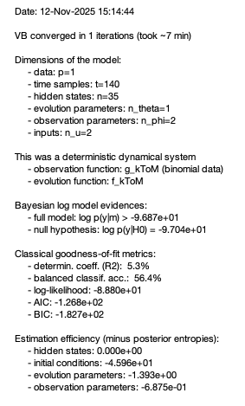
K=2

Slide 4
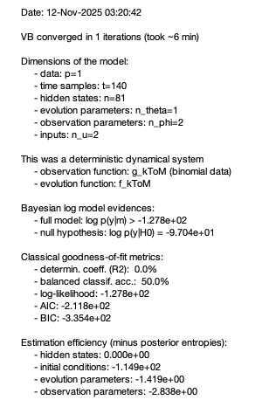
K=3

Slide 5
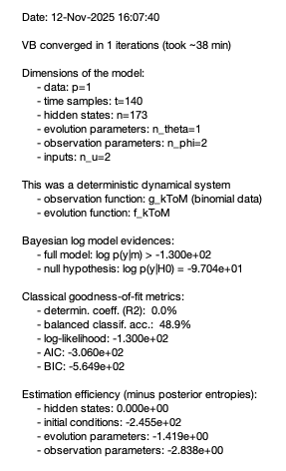
K=4

